Slide 1
artificial intelligence and the future of the legal profession, the practice of law & legal education
William N. Eskridge Jr.
Alexander M. Bickel Professor of Public Law, Yale Law School
Connecticut Bar Association
October 2023

Slide 2
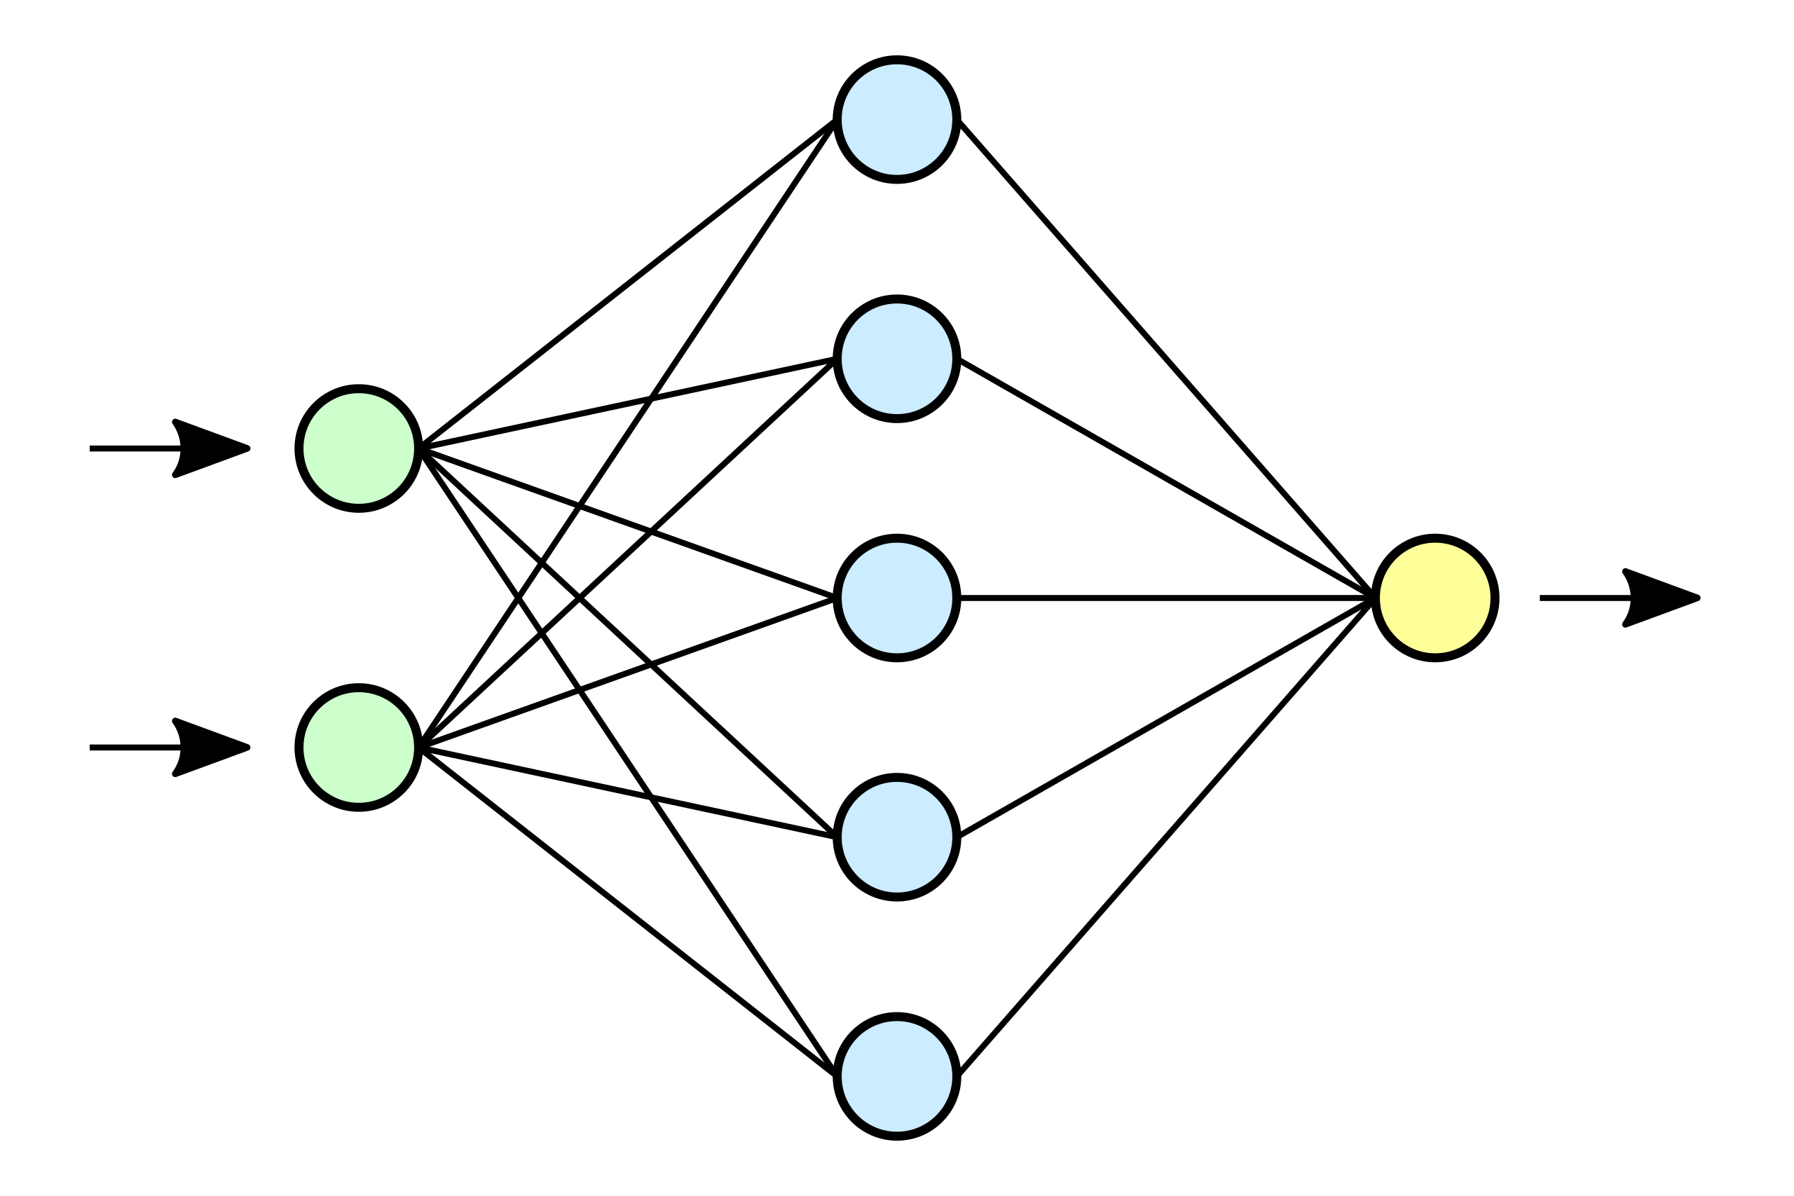
Premise: AI As Deep learning (DL)
Older computer programs (TurboTax) operate by conditional logic (if a, then b). Deep Learning operates through numerical feedback loops that self-correct and learn. Chat GPT4 translates verbal inputs (green dots) into numbers processed by thousands of neural networks (blue) that operate by predicting the next work (numerical vector) and reevaluating until it reaches a coherent output, which is translated from numbers into words (yellow dot).

Slide 3
Premise: AI cannot quite do Legal reasoning
Current technology, Deep Learning (AI) cannot do complex legal reasoning the way a trained lawyer can.
● reason by analogy/distinguish precedent;
● analysis of statutory plans/structures;
● evaluate each bit of relevant evidence (e.g., word meaning) in light of the other evidence (e.g., whole act, purpose, precedents);
● apply legal principle to facts and equity;
● adjust for institutional considerations;
● make normative judgments.

Slide 5
HOW AI IS TRANSFORMING THE PRACTICE OF LAW

Slide 6
General
Clients
(1) interactive + informative websites
(2) class action plaintiffs and parties
(3) estimate costs and expected returns + allocate resources.
Automation of Routine Tasks
(1) conflict of interest
(2) billing clients
(3) retrieving dox
(4) analyzing dox
(5) reviewing draft contracts etc.
(6) discovery (TAR)
Legal Research
(1) judicial decisions
(2) statutes on point or related statutes
(3) agency regulations
(4) Predictions
(5) relevant law in other countries
(6) treaties, int’l law

Slide 8
Litigation
Predictive Judgments
(1) whether to bring suit
(2) where to bring suit
(3) what to ask for
E-Discovery
TAR can search massive electronic files to identify relevant documents
Drafting Legal Documents
Chat GPT4 can draft letters, memoes, briefs
Human lawyer must review such products.
[NB This + prior slide drafted by GPT4]

Slide 9
How ai will affect the Structure of legal practice

Slide 10
Structure
Personnel Changes
Reduced need for junior attorneys/paralegals, increased need for technology c staff and managers
Client Relationships.
AI efficiencies will undermine “bill by the hour” model for client charges. Movement toward “bill by the service.”
Structure of Law Firms.
Away from the Traditional Pyramid and toward a Tech Pyramid (see next slide). Pressure for Bar Ass’ns to permit equity ownership by nonlawyers. Cf. CT Rule 5.4.

Slide 11
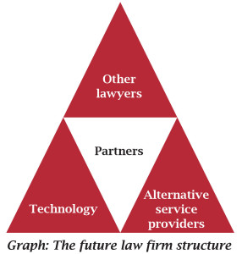
emergent law firm structure?

Slide 12
Competitive Advantages
Winners:
Class action firms? Impact litigation
Corporate law departments
Big Firms that get the “best” AI technology early
Losers:
Big Firms that move slowly: lose corporate clients
Firms that move too quickly and adopt soon-obsolete tech
Small practitioners?

Slide 13
Robolawyers? Most americans w/ legal problems do not have lawyers. Can ai help these folks?
■ Interactive Websites providing useful legal information and answering routine legal questions from lay persons
■ Legal Aid, law school clinics, other nonprofits can represent more clients with the aid of AI in screening (client triage), information-gathering, preliminary drafting, and legal research
■ DoNotPay, where an AI program “represents” people and does legal filings for them. Quality-control and ethics problems. Cf. Faridian v. DoNotPay (Cal. Super. Ct., filed March 2023) (class action under the California UPL Act).

Slide 15
AI & Legal Ethics

Slide 16
Client representation
Rule 1.1. Competence
Comments to CT’s Competence Rule require a lawyer to “keep abreast of changes in the law and its practice, including the benefits and risks associated with relevant technology.”
Rule 1.4. Client Communication
Client must be informed of AI use, especially as it affects costs and potential privacy issues. Perhaps also conversation about AI protocols below.
Rule 1.6.Confidential Client Information
Client information provided to an AI usually accessible to system’s developers. Lawyers must understand system’s protocols, explain to client and (IMHO) secure informed consent from client.

Slide 17
property issues
Work Product?
Using Technology Assisted Review for discovery, lawyers identify a “seed set” of documents and classify them as responsive or not. AI then sorts the documents in the data set; lawyer fine-tunes the seed. Is the seed set, as fine-tuned, “work product” generally protected from disclosure? Trend: Yes?
Trade Secrets?
If a firm licenses technology from a third party, it usually recognizes the vendor’s property interest. Can a court require the firm to share that technology? Assume: No? If a firm develops its own AI platform, trained on the firm’s own data, is that a trade secret entitled to protection against disclosure, even in litigation?

Slide 18
Duty to supervise
CT Rule 5.1: law firm partners/managers must create protocols to assure firm compliance with the Rules and must supervise lawyers. You need to know whether/to what extent your associates are using AI.
CT Rule 5.3: lawyer must make reasonable efforts to ensure that the conduct of a non-lawyer service provider is compatible with lawyer’s duties. Hence, AI’s hallucinations/mistakes are your mistakes.
CT Rule 1.6(f): lawyer shall exercise reasonable care to prevent other employees, associates, and service providers from disclosing or using the secrets of a client.

Slide 19
Legal profession Issues
CT Rule 5.4(d) prohibits law firms from having nonlawyer equity or control ownership. The new model for the law firm (larger role for tech officials and staff) and the capital requirements for creating AI advantages (purchasing or developing the best tech, training it through the law firm’s own database) will put pressure on this.
CT Rule 5.5 and C.G.S. 51-88(a), prohibit the “unauthorized practice of law” in CT. Might apply to DoNotPay, cf. Faridian v. DoNotPay (Cal. Super. Ct., filed March 2023), but also might stymie AI programs that allow unrepresented litigants to defend themselves (e.g., tenants) against Repeat Players suing them or to bring their own small lawsuits (e.g., consumer complaints, workers’ rights).

Slide 20
How ai will transform legal education

Slide 21
Legal education: First Year
Technology has already transformed the teaching of legal research in the first year. LEXIS and Westlaw > F.3d & Shephards
Law students are already using Chat GPT4. Integrate AI into legal writing instruction.
Co-taught by Jeff Chivers and Theo Rostow, Yale Law will offer (Fall 2024) an experimental Civil Procedure Small Group where all work is done through an AI Platform. All law schools will have to introduce AI to first-year students.

Slide 23
Advanced Courses
AI-Centered Courses. YLS is now offering every year a course on AI, the Legal Profession & Procedure (previous slide) as well as AI Regulation & Policymaking.
AI-Relevant Courses. In addition to Civil Procedure and Access 2 Justice, AI is transforming the scholarship and teaching of Administrative Law, as agencies have been using algorithms to enforce statutes.
More in Near Future. Intellectual Property is increasingly concerned with AI. Future: Criminal Law & Procedure; Legislation & Statutory Interpretation; Many More

Slide 24
Clinical education most law schools have variety of clinical programs, considered an important part of student’s education
Client Screening & Triage
Document Management & Analysis.
Law School-Supported Websites for Public

Slide 25
The End
Questions?
Different Prophecies?

