Slide 1
Total Apprehensions Apprehensions of Children UAC Apprehensions 2012 364,768 31,029 24,481 2013 420,789 47,397 38,833 2014 486,651 107,613 68,631 2015 337,117 62,167 40,035 2016 415,816 102,264 59,757 2017 310,531 82,769 41,546 2018 404,142 107,498 50,145 2019 859,501 321,708 76,136 2020 405,036 40,740 19,657 2021 1,662,167 293,218 140,230 2022 2,214,652 **unpublished** 149,000 Source: U.S. Customs and Border Protection

Slide 2
CBP Processing Facility Brownsville, TX 2014 Source: The Nation

Slide 3
CBP Processing Facility Donna, TX 2021 Source: CNN

Slide 4
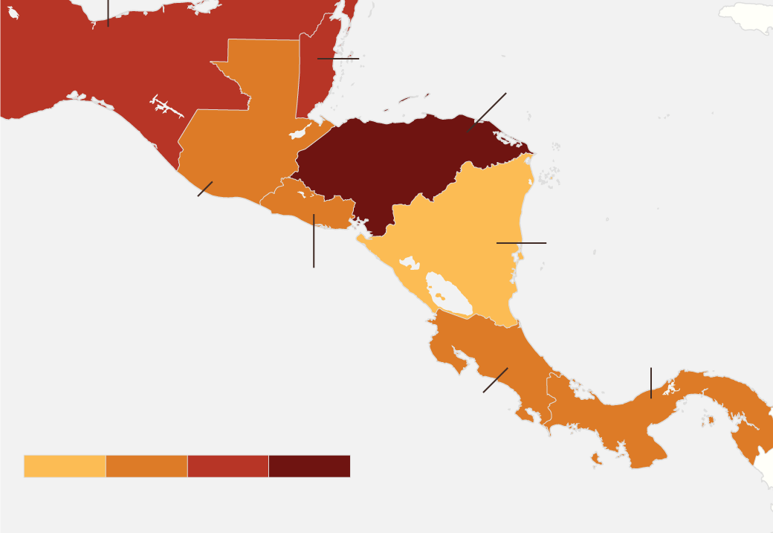
Mexico
26
Honduras
39
Homicide Rates in the Northern Triangle & Surrounding Region 2021
Source: InSight Crime
Guatemala
17
Nicaragua
6
El Salvador
18
Rates per 100,000 people
0 – 9 10 – 19 20 – 29 30+

Slide 7
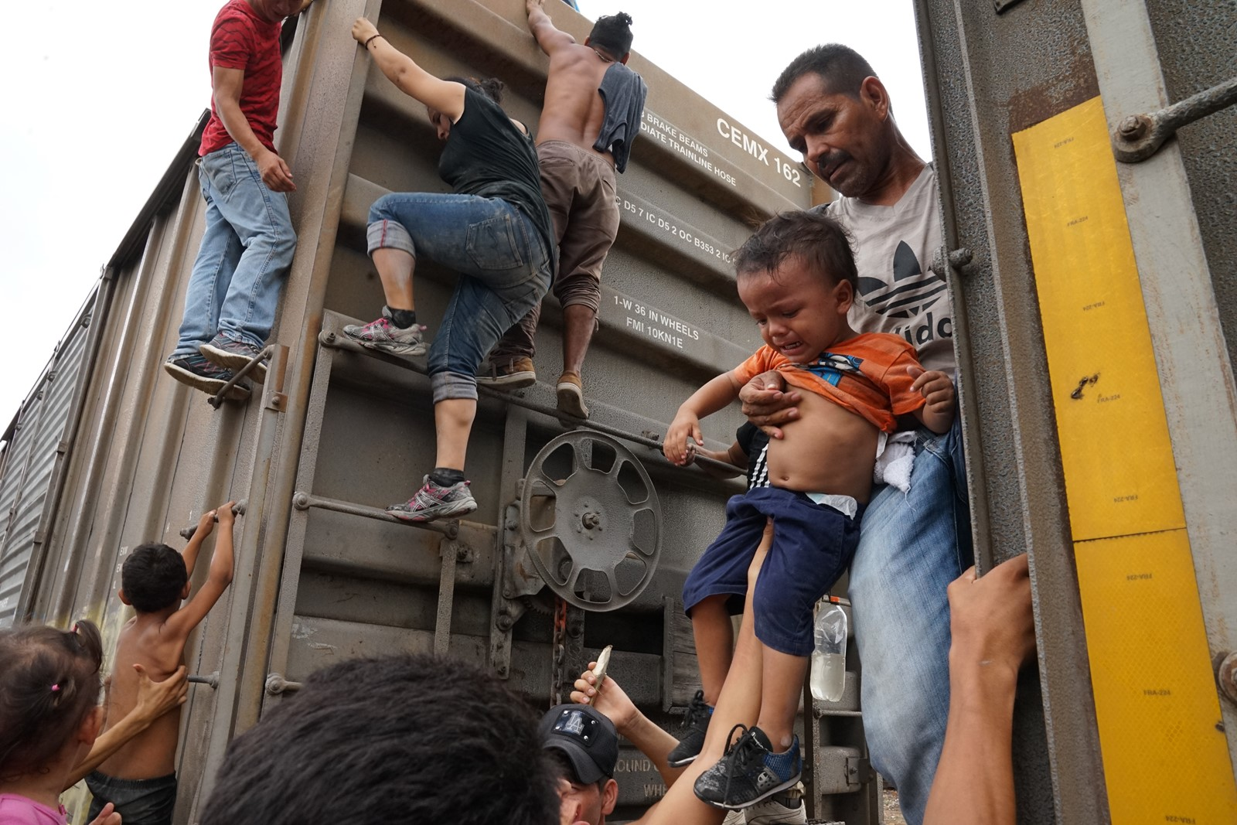
“La Bestia” (The Beast)
Mexico
2019
Source: Liliana Nieto Del Rio for The Times

Slide 8
Source: The Associated Press

Slide 9
McAllen, TX
2018
Source: John Moore, Getty Images

Slide 10
Senda da Vida Tent Camp
Reynosa, Mexico
2022 Source: Michael Nigro, Getty Images

Slide 11
Tent Camp
Matamoros, Mexico
2019 Source: John Moore, Getty Images

Slide 12
Oscar & Valeria 2019 Source: Julia Le Duc, AP

Slide 13
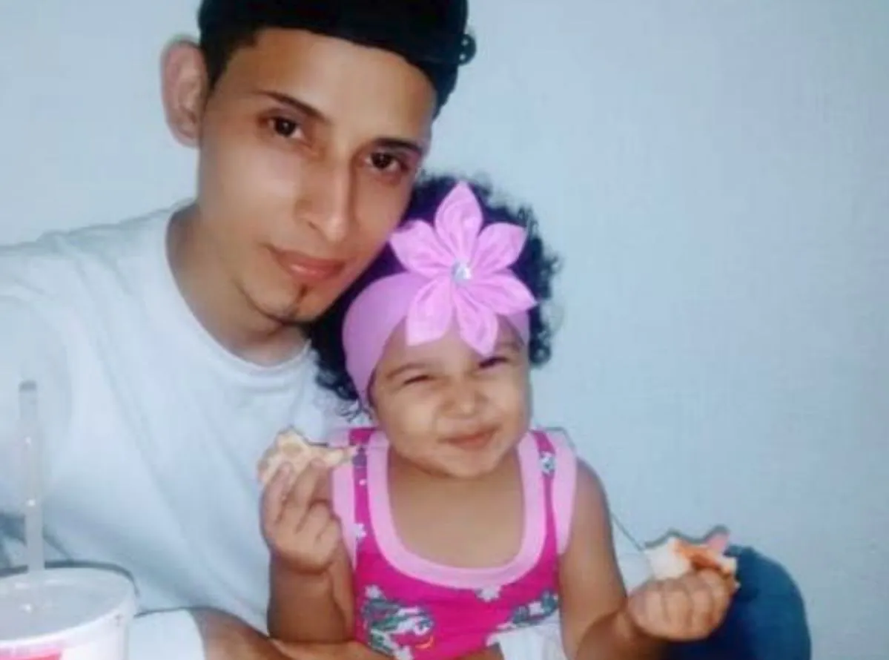
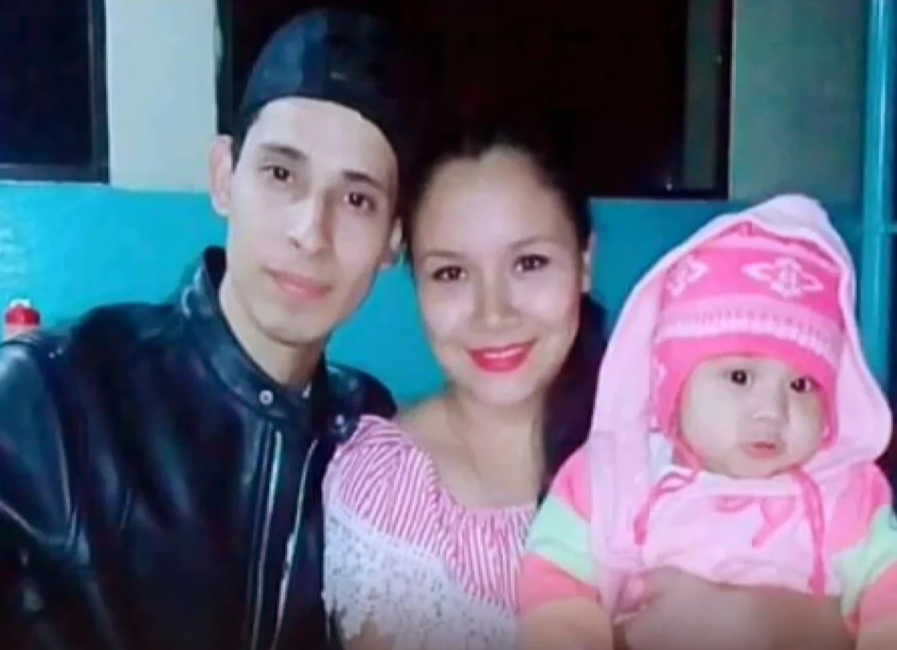
Oscar & Valeria 2019 Source: Maria Estela Avalos

Slide 15
Jakelin Amei Rosmery Caal Maquin
2018
Source: The Caal Family

Slide 16
Funeral of Jakelin Caal Maquin
San Antonio Secortez, Alta Verapaz, Guatemala
2018
Source: Johan Ordonez, Getty Images

